Slide 1
Logistic regression
Lee-Ad Gottlieb

Slide 2
Learning
Classification: {0,1}
Example: SVM gives sign(wx)
Regression: [0,1]
Example: Linear regression gives wx
Maximum Likelihood: Probability that 1 is true
(usually done for two classes {0,1})
Example: Logistic regression
Can do classification too: [Pr > .5]

Slide 3
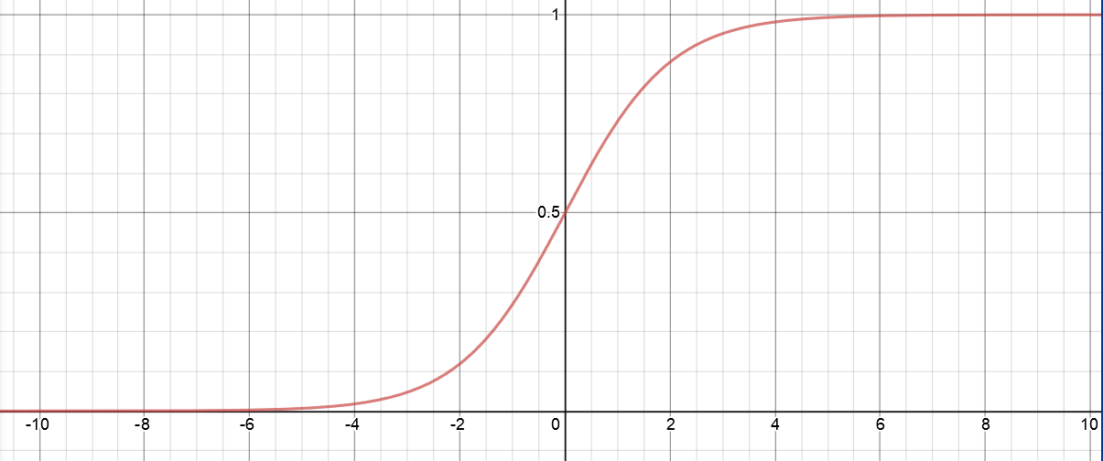
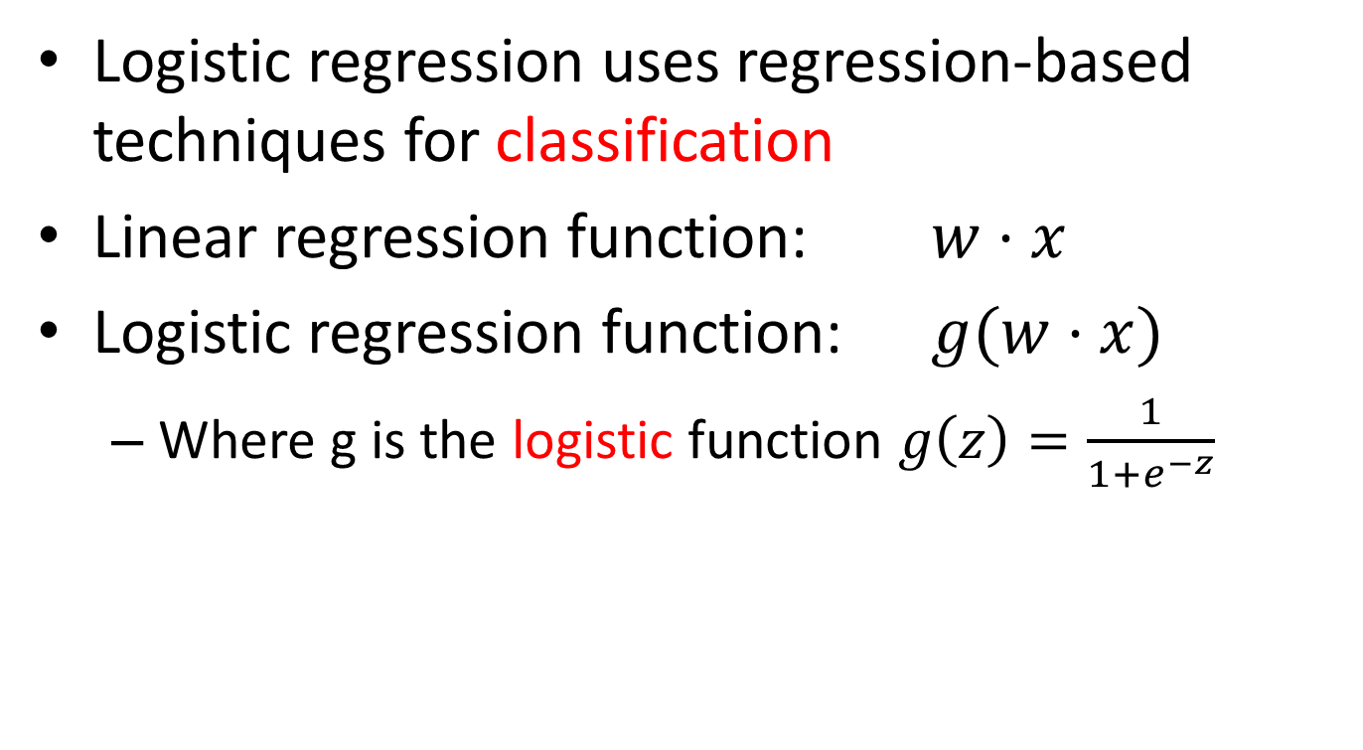
Logistic regression
Logistic regression uses regression-based techniques for classification
Linear regression function: $w⋅x$
Logistic regression function: $g(w⋅x)$
Where g is the logistic function $g\left(z\right)=\frac{1}{1+e^{−z}}$

Slide 4
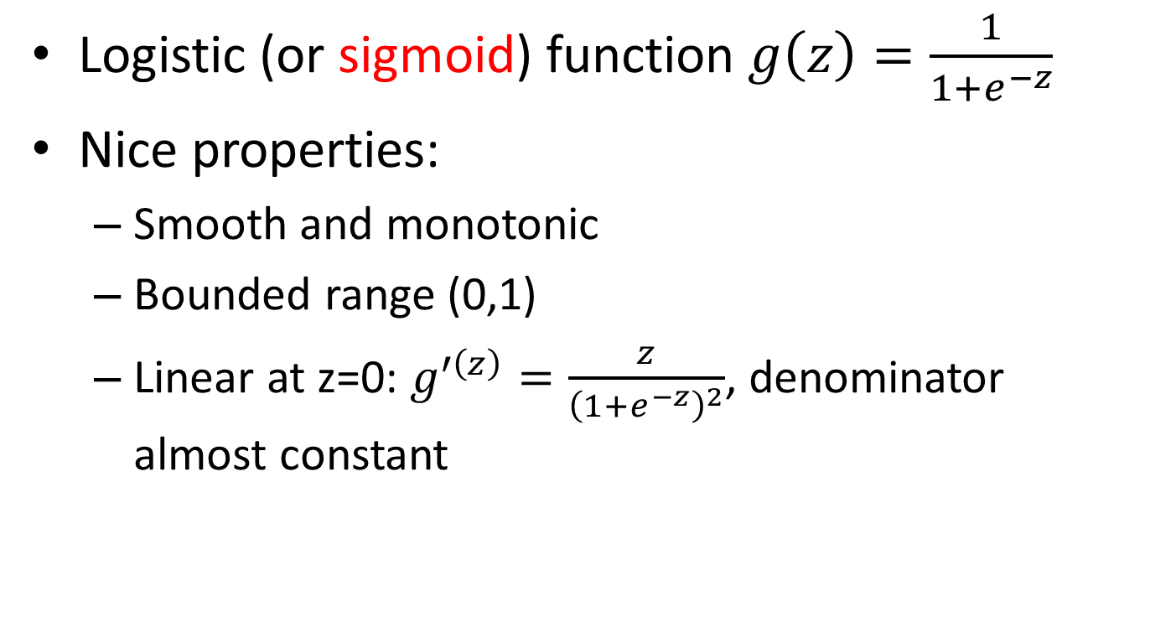
Logistic function
Logistic (or sigmoid) function $g\left(z\right)=\frac{1}{1+e^{−z}}$
Nice properties:
Smooth and monotonic
Bounded range (0,1)
Linear at z=0: $g^{′\left(z\right)}=\frac{z}{{\left(1+e^{−z}\right)}^{2}}$, denominator almost constant

Slide 5
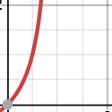
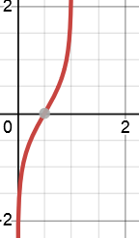
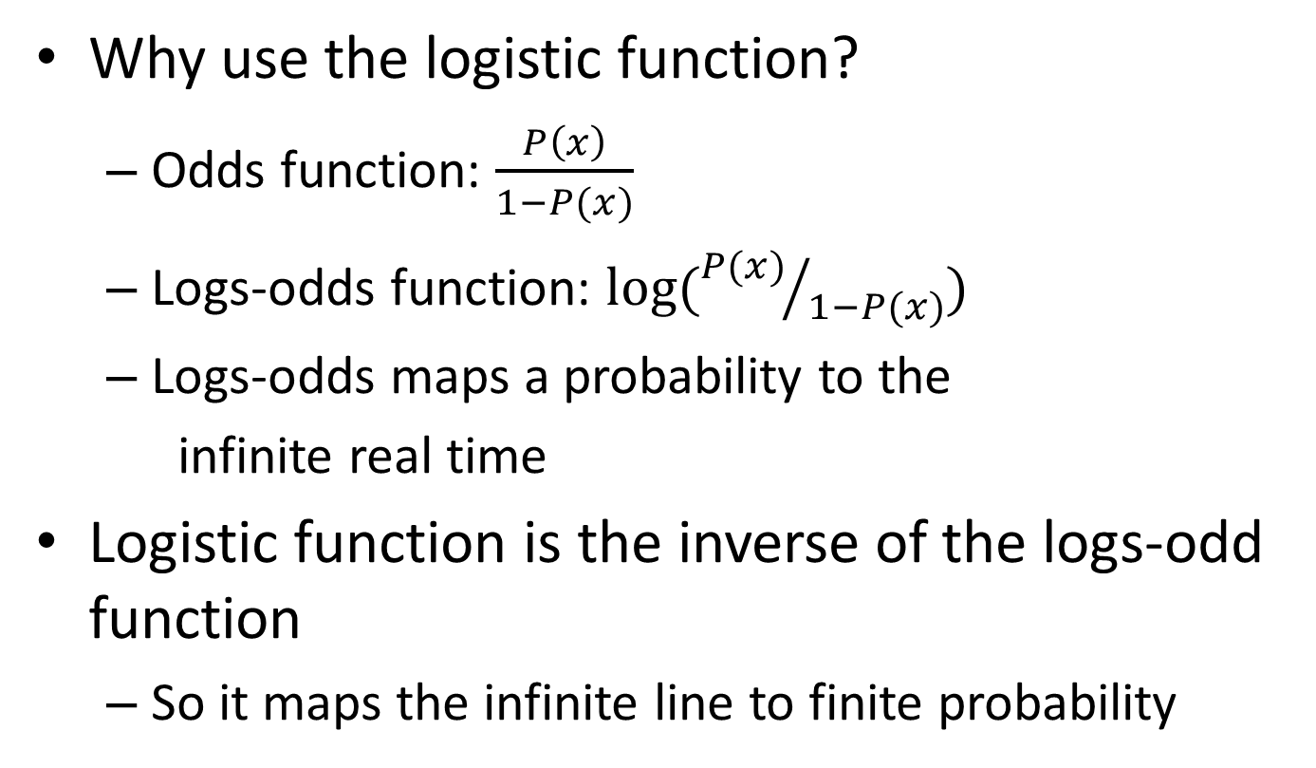
Why use the logistic function?
Odds function: $\frac{P\left(x\right)}{1−P(x)}$
Logs-odds function: $\log{({P(x)}/{1−P(x)})}$
Logs-odds maps a probability to the
infinite real time
Logistic function is the inverse of the logs-odd function
So it maps the infinite line to finite probability

Slide 6
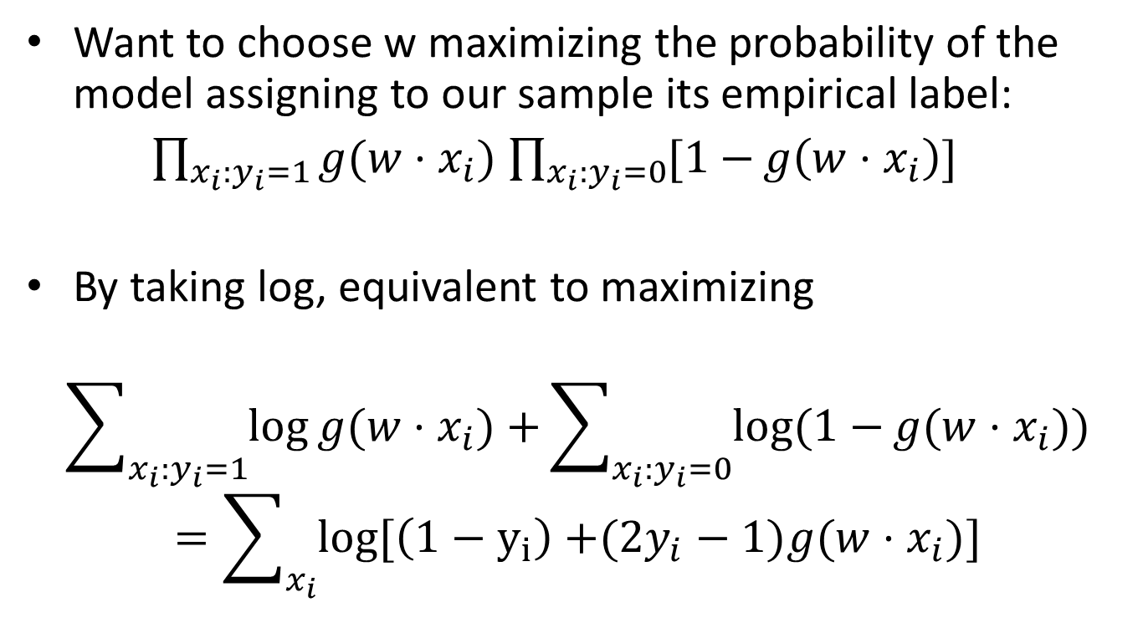
Logistic regression
Want to choose w maximizing the probability of the model assigning to our sample its empirical label:
$\prod_{x_{i}:y_{i}=1}{g(w⋅x_{i})}$ $\prod_{x_{i}:y_{i}=0}{[1−}g\left(w⋅x_{i}\right)]$
By taking log, equivalent to maximizing
$$\sum_{x_{i}:y_{i}=1}{\log{g(w⋅x_{i})}+}\sum_{x_{i}:y_{i}=0}{log(1−{g(w⋅x_{i}))}}$$
$$=\sum_{x_{i}}{log[\left(1−y_{i}\right)+{(2y_{i}−1)g(w⋅x_{i})]}}$$

